Slide 1
Microservices Architecture
&
Spring Boot with Spring Cloud

Slide 2
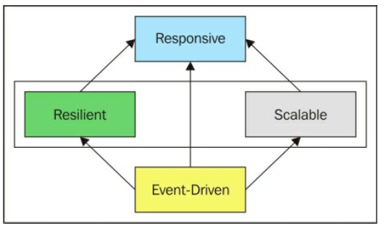
Reactive Systems
Each reactive system should be message-driven (event-driven). That way, it can become loosely coupled and therefore scalable(elastic) and resilient (fault-tolerant), which means it is reliable and responsive.

Slide 3
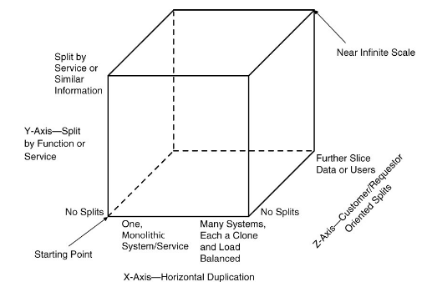
Scalability- Scale cube

Slide 4
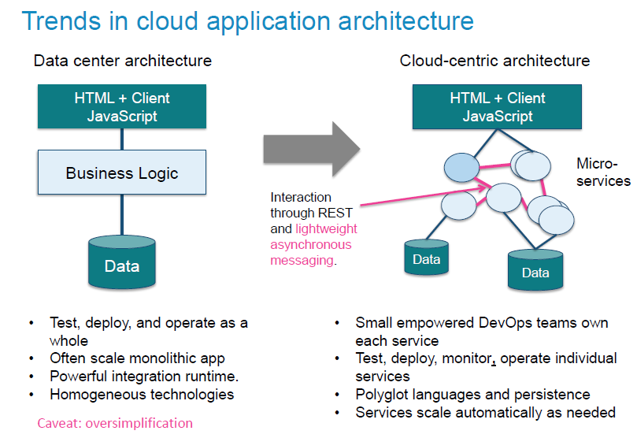
Microservices Approach

Slide 5
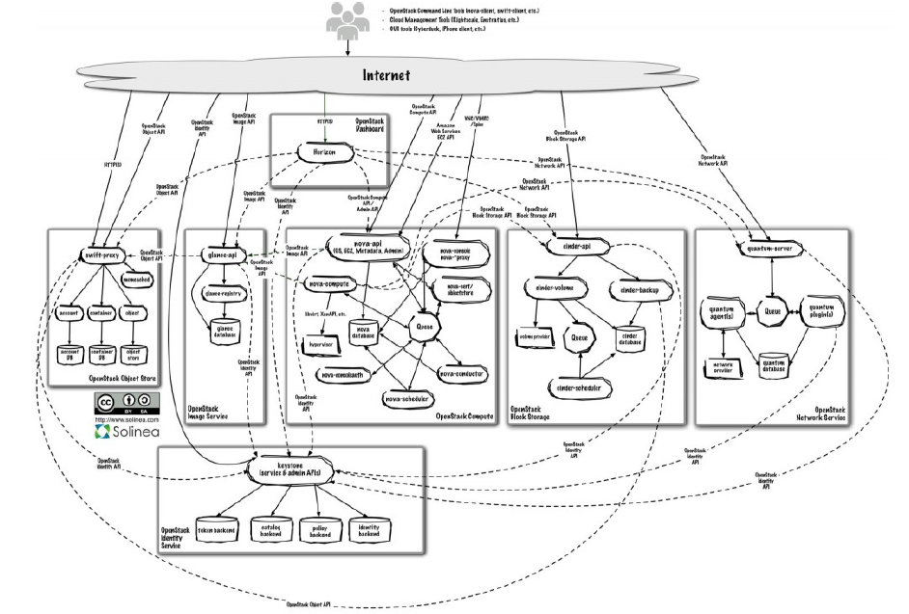
Open Stack – IaaS Cloud platform – Microservices Architecture

Slide 6
Eight fallacies of distributed computing
Essentially everyone, when they first build a distributed application, makes the following eight assumptions. All prove to be false in the long run and all cause big trouble and painful learning experiences.
The network is reliable
Latency is zero
Bandwidth is infinite
The network is secure
Topology doesn't change
There is one administrator
Transport cost is zero
The network is homogeneous

Slide 7
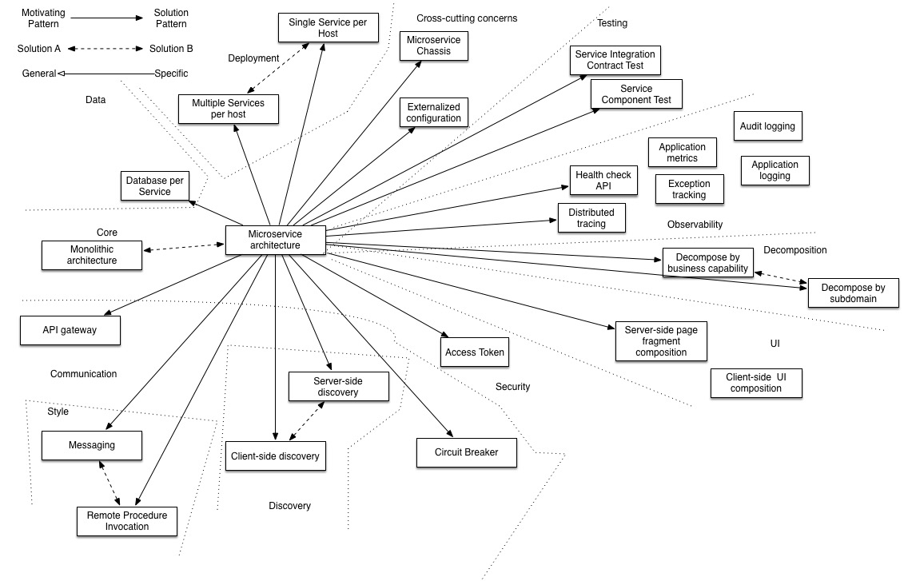
Microservices Architecture & related patterns

Slide 8
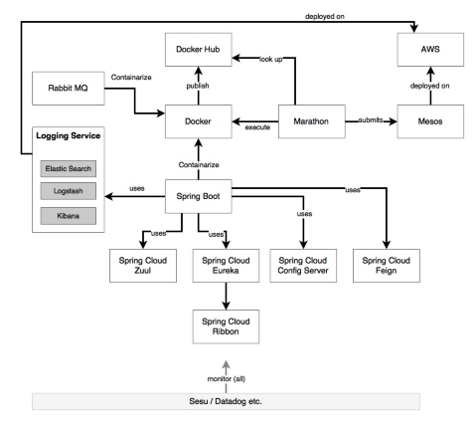
Microservices Technology Model - Example

Slide 9
Microservices Architecture Characteristics
Small, and Focused on Doing One Thing Well [Single Responsibility Principle, Cohesion, Separation of concerns, Collaboration, Event Driven]
Scaling[scale cube]
Resilience [isolate failures]
Autonomous [deployed separate and API based]
Technology Heterogeneity [languages used for specific purpose]
Ease of deployment [quick change]
Organization alignment [Conway’s law, sweet spot of team size and productivity]
Composability[reuse of functionality- SOA]
Optimization for replaceability [small and ease to replace]

Slide 10
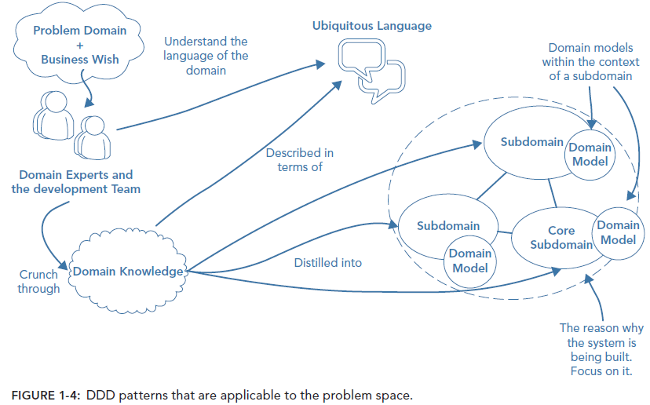
Domain Driven Design – Problem Domain

Slide 11
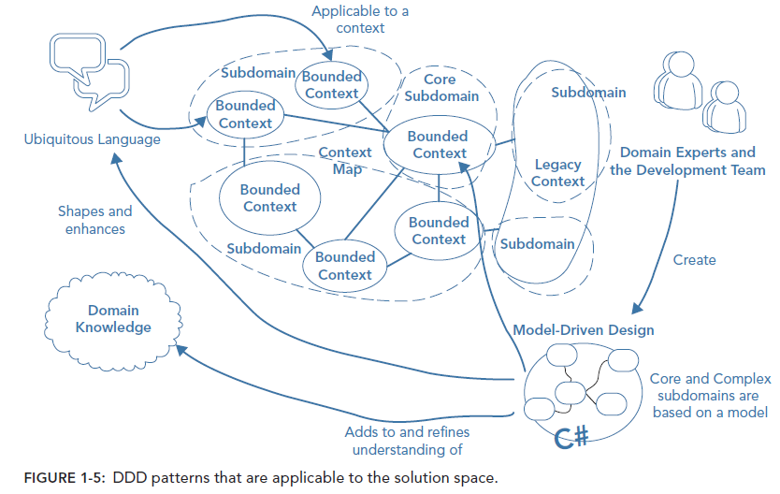
Domain Driven Design - Solution Domain

Slide 12
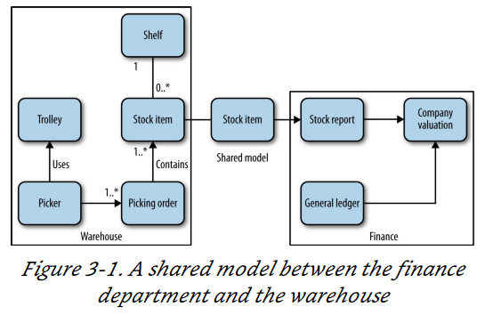
Bounded context

Slide 13
Service Design
Good Service Design – Loose coupling and high Cohesion
Domain -> Bounded Context (shared and hidden model)
Service boundaries should align with bounded context
Risk of premature decomposition
Business capabilities provided by bounded context to rest of the domain is important. thinking about data leads to anemic, CRUD-based (create, read, update, delete) services. So ask first “What does this context do?” ->Business capabilities [Service catalog]
Interplay of organization design with software architecture
Interface [shared model] should be based on business dictionary
Technical boundary - Identify technical slices after identifying business focused slices

Slide 14
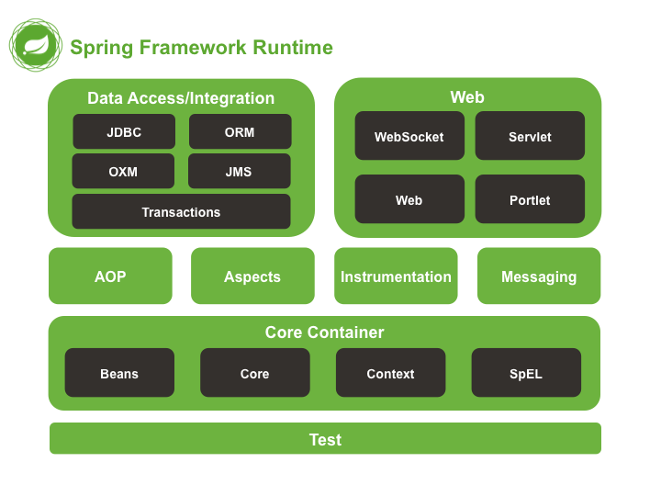
Spring framework
https://spring.io/guides

Slide 15
Spring Framework
Spring employs four key strategies:
Lightweight and minimally invasive development with POJOs
Invasive programming - No need to implement frameworks interfaces or extend existing classes. E.g. EJB 2.0 Stateless beans, earlier version of struts, webwork, tapestry etc.,
Loose coupling through DI and interface orientation
Tight coupling – difficult to reuse, difficult to test
Configuration options ->
Explicit configuration – java(more powerful, type-safe and refractor-friendly) or XML(Usually no source available/external libraries)
@Configuration,@bean/@Conditional/@Scope, @Import,
@importResource
- dependencies by constructor(heavy dependency) or property(optional
dependency)
automatic configuration by source code level annotation
@configuration, @ComponentScan, @Component /@Qualifier/@Value->
@Autowired/@Qualifier
Environment and profiles @ActiveProfile – implementation of @Conditional

Slide 16
Spring Framework
Conditional beans [ConditionContext, AnnotatedTypeMetadata] @Conditional
Suppose you want one or more beans to be configured if and only if some library is available in the application’s classpath. Or let’s say you want a bean to be created only if a certain other bean is also declared. Maybe you want a bean to be created if and only if a specific environment variable is set.
Addressing ambiguity in autowiring @Qualifier, @Primary
Scoping beans @Scope [singleton, prototype, session, request],
Runtime value injection [Property placeholders @PropertySource, SpEL]
- PropertySourcesPlaceholderConfigurer
Declarative programming through aspects and common conventions. System services such as logging, transaction management, and security often find their way into components whose core responsibilities is something else. These system services are commonly referred to as cross-cutting concerns because they tend to cut across multiple components in a system.
Eliminating boilerplate code with aspects and templates

Slide 17
Spring Boot
Starter dependencies
Automatic configuration
The actuator
Notes:
Starter dependency - It can be challenging to add dependencies to a project’s build. What library do you need? What are its group and artifact? Which version do you need? Will that version play well with other dependencies in the same project?
By adding spring-boot-starter-web dependency. This single dependency will transitively pull in all of those other dependencies so you don’t have to ask for them all(spring-core,-web,webmvc,jakson,hibernate-validator, tomcat-embed-core, tomcat-embed-el, tomcat-embed-loging-juli) . In short, you no longer need to think about what libraries you’ll need to support certain functionality; you simply ask for that functionality by way of the pertinent starter dependency.
Automatic Configuration
XML deployment configuration – web.xml, spring-application-config. Xml’s with bean and wiring defns
Annotations used for all components @Component (servelts, filter, listener, controller, service, entity, resource etc.,) and @autowiring avoided XML configuration. Requested @Configuration java class only for custom intialiazed beans
ViewResolver,TemplateResolver, MultipartResolver,
DataSource, JDBCTemplate, TransactionManager, JPAImplementation,EmbededDatabaseBuilder
The above configurations are automatically added by Spring Boot If Spring Boot detects that you have the H2 database library in your application’s classpath, it will automatically configure an embedded H2 database. If JdbcTemplate is in the classpath, then it will also configure a JdbcTemplate bean for you.
Java –jar *.jar --debug
Spring boot leverages conditional configuration features from Spring 4, along with transitive dependency resolution offered by Maven and Gradle, to automatically configure beans in the Spring application context. In short, at its heart, Spring Boot is just Spring. Inside, Spring Boot is doing the same kind of bean configuration in Spring that you might do on your own if Spring Boot didn’t exist. Thankfully, because Spring Boot does exist, you’re freed from deal in with explicit boilerplate configuration and are able to focus on the logic that makes your application unique.
Actuator
Meaning of Actuator
The Actuator instead offers the ability to inspect the internals of your application at runtime. With the Actuator installed, you can inspect the inner workings of your application => beans in springapplicaitoncontext, decisions made by spring boot auto configurations, external variables(env,system,args,conf properties), thread state, recent http request trace, metrics – memory usage, gc, web requests and data source usage

Slide 18
Spring boot and Micro services
From microservices point of view, one needs a mechanism to develop services as executables, self-contained JAR files with an embedded HTTP listener.
The framework uses an opinionated approach over configurations for decision making, thereby reducing the effort required in writing a lot of boilerplate code and configurations.
Also provides a set of production-ready ops features such as health checks and metrics collection.
Spring Boot recognizes the nature of the application based on the libraries available in the class path and runs the auto configuration classes packaged in these libraries
Spring Boot also enables microservices' development by packaging all the required runtime dependencies in a fat executable JAR file.

Slide 19
Spring Cloud
Spring Cloud provides tools for developers to quickly build some of the common patterns in distributed systems. Please refer https://spring.io/guides for examples
Centralized Configuration
Client side load balancing
Dynamic service registration and discovery
API Gateway Routing & Filtering
Circuit breakers
micro-proxy
control bus
one-time tokens
global locks
leadership election
distributed sessions
cluster state

Slide 20
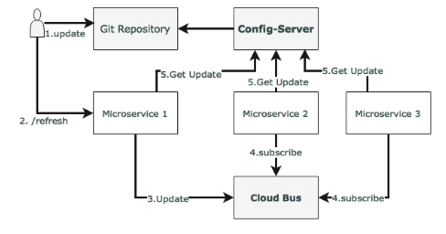
Centralized Configuration – Spring Cloud Config

Slide 21
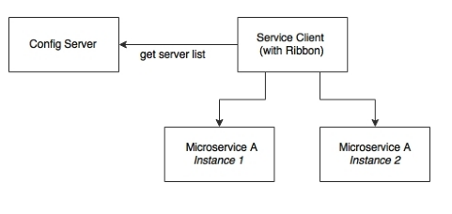
Client side load balancing - Ribbon

Slide 22
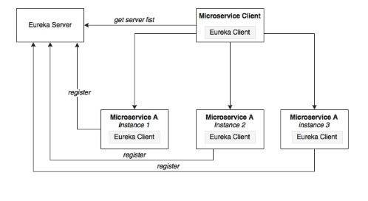
Dynamic Service Registration and Discovery - Eureka

Slide 23
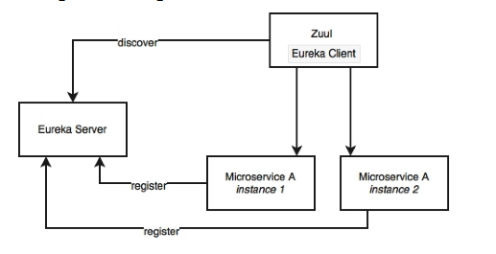
API Gateway Routing & Filtering - Zuul

Slide 24
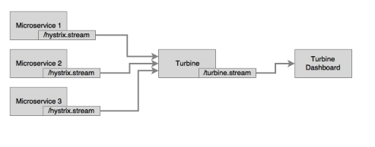
Circuit Breaker & Monitoring – Hystrix & Turbine

Slide 25
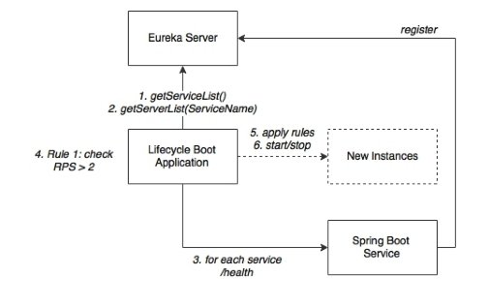
AutoScaling

Slide 26
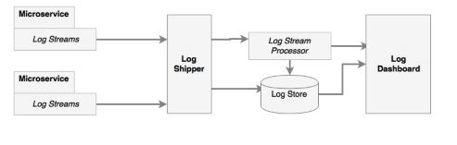
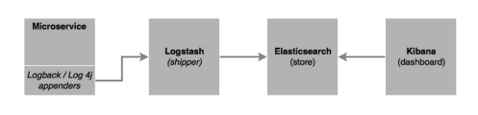
Centralized Logging

Slide 27
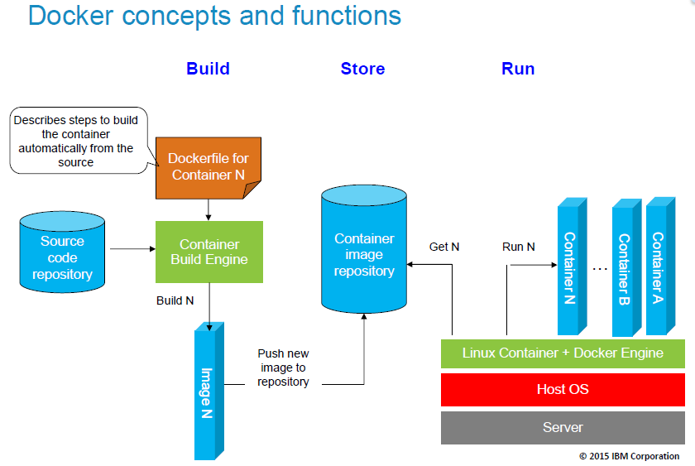
Docker

Slide 28
12 factor App
Codebase – One codebase tracked in revision control with multiple deployments
Dependencies - Explicitly declare and isolate dependencies
Config - Store configuration in the environment
Backing Services – Treat backing services as attached resources
Build, release, run - Strictly separate build and run stages
Processes - Execute the app as one or more stateless processes
Port binding - Export services by using port binding
Concurrency – Scale out by using the process model
Disposability – Maximize robustness with fast startup and graceful shutdown
Dev/prod parity – Keep development, staging, and production as similar as possible
Logs - Treat logs as event streams
Admin processes - Run administrator and management tasks as one-off processes

